Slide 1
Chapter 5
The Cellular Concept

Slide 2
Outline
Cell Shape
  Actual cell/Ideal cell
Signal Strength
Handoff Region
Cell Capacity
  Traffic theory
  Erlang B and Erlang C
Cell Structure
Frequency Reuse
Reuse Distance
Cochannel Interference
Cell Splitting
Cell Sectoring

Slide 3
Cell Shape
R
R
R
Cell
R
R
(a) Ideal cell
(b) Actual cell
(c) Different cell models

Slide 4
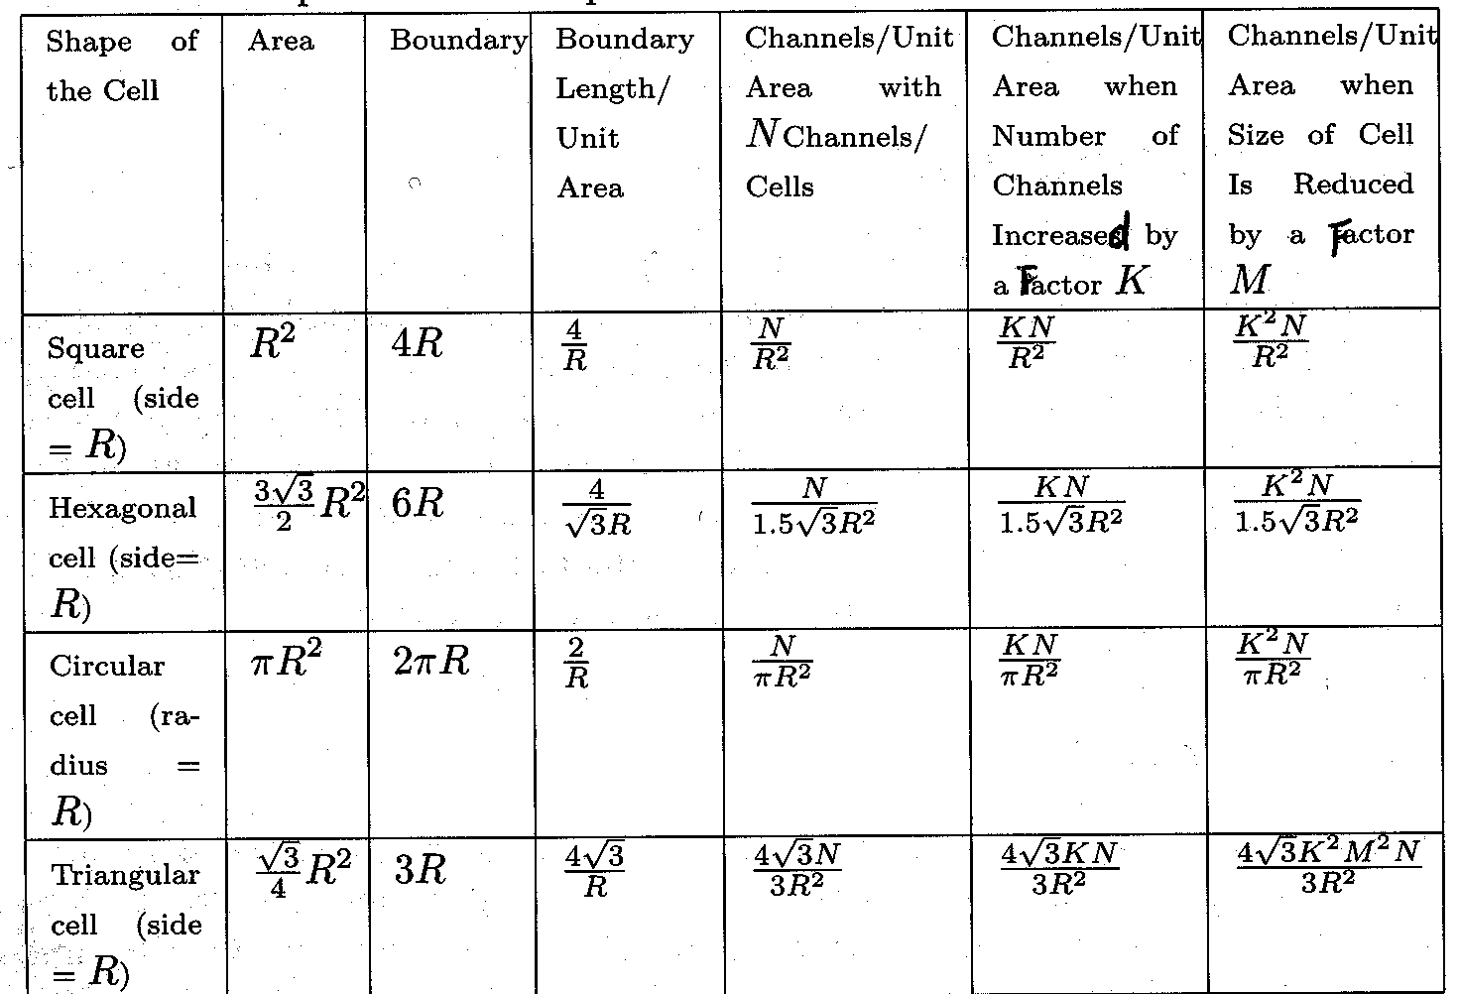
Impact of Cell Shape and Radius on Service Characteristics

Slide 5
Signal Strength
Signal strength (in dB)
Cell i
Cell j
-60
-60
-70
-70
-80
-80
-90
-90
-100
-100
Select cell i on left of boundary
Select cell j on right of boundary
Ideal boundary

Slide 6
Signal Strength
Signal strength (in dB)
Cell i
Cell j
-60
-70
-60
-80
-70
-90
-80
-90
-100
-100
Signal strength contours indicating actual cell tiling. This happens because of terrain, presence of obstacles and signal attenuation in the atmosphere.

Slide 7
Handoff Region
Signal strength due to BS_{i}
Signal strength due to BS_{j}
P_{i}(x)
P_{j}(x)
E
P_{min}
BS_{i}
MS
BS_{j}
X₁
X₃
X₅
X_{th}
X₄
X₂
By looking at the variation of signal strength from either base station it is possible to decide on the optimum area where handoff can take place.

Slide 8

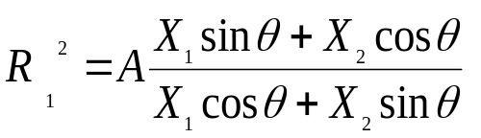
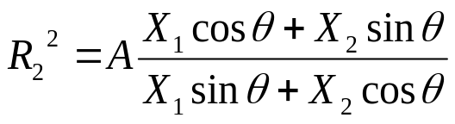
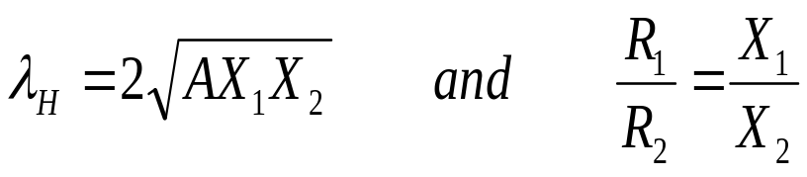
Handoff Rate in a Rectangular
Since handoff can occur at sides R ₁ and R ₂ of a cell
R₂
where A=R ₁ R ₂ is the area and assuming it constant, differentiate with respect to R₁ (or R ₂) gives
X₂
θ
R₁
X₁
θ
Total handoff rate is
λ_{H} is minimized when θ=0, giving

Slide 9
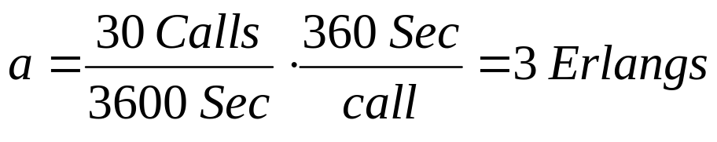
Cell Capacity
Average number of MSs requesting service (Average arrival rate): λ
Average length of time MS requires service (Average holding time): T
Offered load: a = λT
e.g., in a cell with 100 MSs, on an average 30 requests are generated during an hour, with average holding time T=360 seconds.
Then, arrival rate λ=30/3600 requests/sec.
A channel kept busy for one hour is defined as one Erlang (a), i.e.,

Slide 10
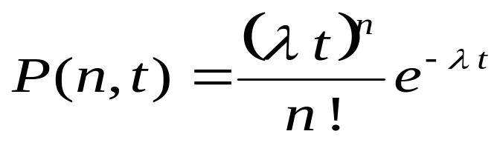
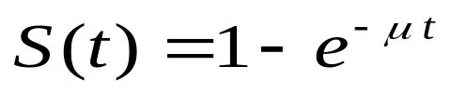
Cell Capacity
Average arrival rate during a short interval t is given by λ t
Assuming Poisson distribution of service requests, the probability P(n, t) for n calls to arrive in an interval of length t is given by
Assuming μ to be the service rate, probability of each call to terminate during interval t is given by μ t.
Thus, probability of a given call requires service for time t or less is given by

Slide 11
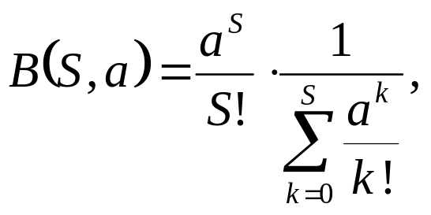
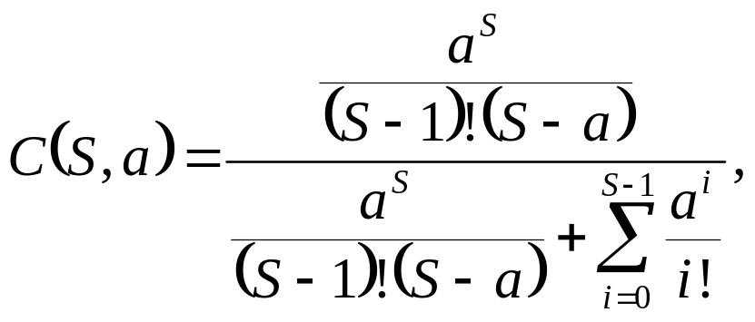
Erlang B and Erlang C
Probability of an arriving call being blocked is
Erlang B formula
where S is the number of channels in a group.
Probability of an arriving call being delayed is
Erlang C formula
where C(S, a) is the probability of an arriving call being delayed with a load and S channels.

Slide 12
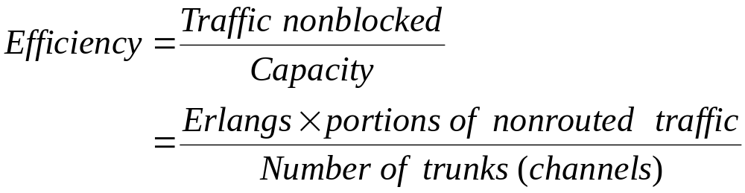
Efficiency (Utilization)
Example: for previous example, if S=2,
then
B(S, a) = 0.6, ------ Blocking probability,
i.e., 60% calls are blocked.
Total number of rerouted calls = 30 x 0.6 = 18
Efficiency = 3(1-0.6)/2 = 0.6

Slide 13
Cell Structure
F7
F2
F1
F2
F1
F2
F6
F1
F3
F1
F2
F3
F3
F3
F4
F5
F4
(a) Line Structure
(b) Plan Structure
Note: Fx is set of frequency, i.e., frequency group.

Slide 14
Frequency Reuse
F7
F2
F7
F2
F6
F1
F3
F1
F6
F1
F3
F1
F5
F4
F7
F2
F5
F4
F7
F2
F6
F1
F3
F1
F6
F1
F3
F1
F5
F4
Reuse distance D
F5
F4
Fx: Set of frequency
7 cell reuse cluster

Slide 15

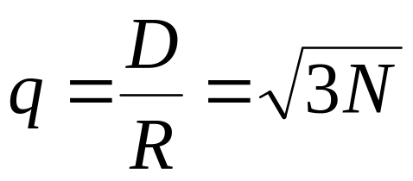
Reuse Distance
R
Cluster
For hexagonal cells, the reuse distance is given by
F7
F2
F6
F1
F3
F1
where R is cell radius and N is the reuse pattern (the cluster size or the number of cells per cluster).
F5
F4
F7
F2
F3
Reuse factor is
F6
F1
F1
Reuse distance D
F5
F4

Slide 16
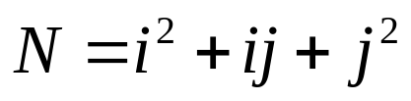
Reuse Distance (Cont’d)
The cluster size or the number of cells per cluster is given by
j
where i and j are integers.
60º
i
N = 1, 3, 4, 7, 9, 12, 13, 16, 19, 21, 28, …, etc.
The popular value of N being 4 and 7.

Slide 17
Reuse Distance (Cont’d)
j=1
j=1
i=2
j direction
i=2
j=1
i=2
60°
i=2
i direction
j=1
1 2 3 … i
j=1
i=2
i=2
j=1
(a) Finding the center of an adjacent cluster using integers i and j (direction of i and j can be interchanged).
(b) Formation of a cluster for N = 7 with i=2 and j=1

Slide 18
Reuse Distance (Cont’d)
j=2
i=3
j=2
i=3
j=2
i=2
j=2
j=2
j=2
i=2
i=2
i=3
i=3
i=2
i=2
j=2
j=2
j=2
i=2
j=2
i=3
j=2
i=3
j=2
(c) A cluster with N =12 with i=2 and j=2
(d) A Cluster with N = 19 cells with i=3 and j=2

Slide 19
Cochannel Interference
First tier cochannel Base Station
Second tier cochannel Base Station
R
D₆
D₅
D₁
D₄
Mobile Station
D₂
D₃
Serving Base Station

Slide 20
Worst Case of Cochannel Interference
D₆
R
D₅
D₁
Mobile Station
D₄
D₂
D₃
Serving Base Station
Co-channel Base Station

Slide 21
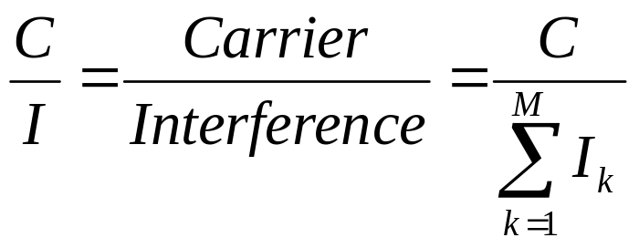
Cochannel Interference
Cochannel interference ratio is given by
where I is co-channel interference and M is the maximum number of co-channel interfering cells.
For M = 6, C/I is given by
C
C
where γ is the propagation path loss slope and γ = 2~5.
=
I
⎛
−γ
M
D
⎞
∑
⎜
k
⎟
⎝
R
⎠
k
=
1

Slide 22
Cell Splitting
Large cell (low density)
Small cell (high density)
Smaller cell (higher density)
Depending on traffic patterns the smaller cells may be activated/deactivated in order to efficiently use cell resources.

Slide 23
Cell Sectoring by Antenna Design
c
c
120º
120º
a
b
a
b
(a). Omni
(b). 120º sector
(c). 120º sector (alternate)
d
f
90º
e
60º
a
a
c
d
b
b
c
(d). 90º sector
(e). 60º sector

Slide 24
Cell Sectoring by Antenna Design
Placing directional transmitters at corners where three
adjacent cells meet
B
C
X
A

Slide 25
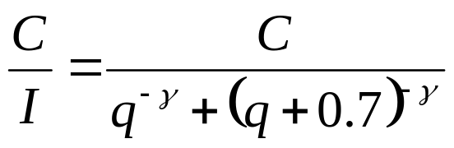

Worst Case for Forward Channel Interference in Three-sectors
BS
D + 0.7R
BS
MS
R
BS
D
BS

Slide 26
Worst Case for Forward Channel Interference in Three-sectors (Cont’d)
BS
D
D’
BS
MS
R
BS
D
BS

Slide 27
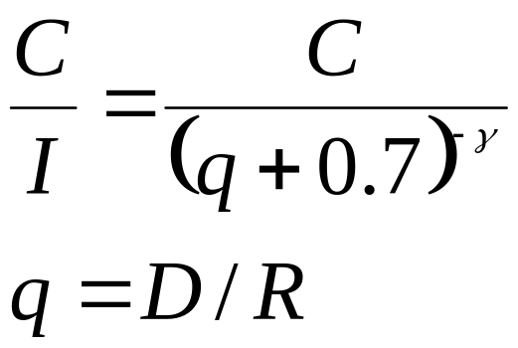
Worst Case for Forward Channel Interference in Six-sectors
MS
BS
R
D +0.7R
BS

